Slide 1
EDITORS
Kristina Myftaraga
Prof. Vladimir Georgiev
FUNDAMENTAL DATA STRUCTURE
CLASS PROJECT

Slide 2
Project description
Program interface
User menu
List editors
List companies
Search
Collections
Handling the data
Algorithms

Slide 3
PROJECT DESCRIPTION
A web-like program named Online Store Menu, which offers a platform for users to access the Editors and Companies. Once the User enters our web-like program, in the Online Store Menu he can Log in/ Register or just View Editor and Companies., and there is a Search button in case they want to search directly for a Promoted Company or Editor.
Each User has their own menu where they can perform different operations like register, login, add or purchase editors depending on their status. The User Menu contains two buttons: Log in and Register. Once the user is Logged in, he has his status appeared in the screen. If he is not part of one of our Promoted Companies, he can only Apply to one of them or Purchase Editors. If he is part of one of our Promoted Companies, he can Add one Editor as well.

Slide 4
CLASS HIERARCHY
EDITORS
PHOTOEDITORS
VIDEOEDITORS
SOCIAL MEDIA
VIRTUAL REALITY
SIMPLE
COMPLEX

Slide 5
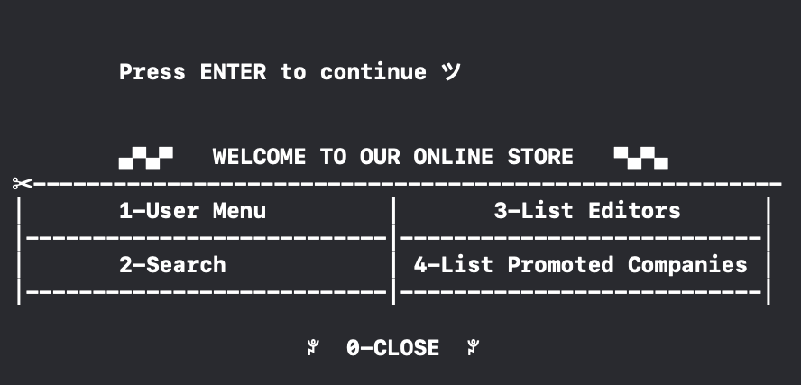
Program Interface

Slide 6
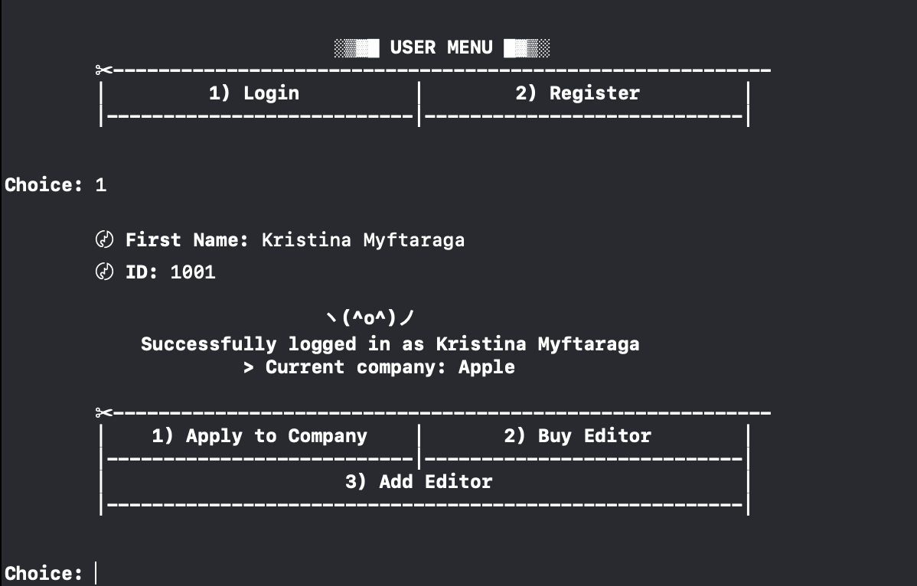
User Menu
Log in or Register
Apply to a company
Buy Editors
Add editors if part of our partner companies

Slide 7
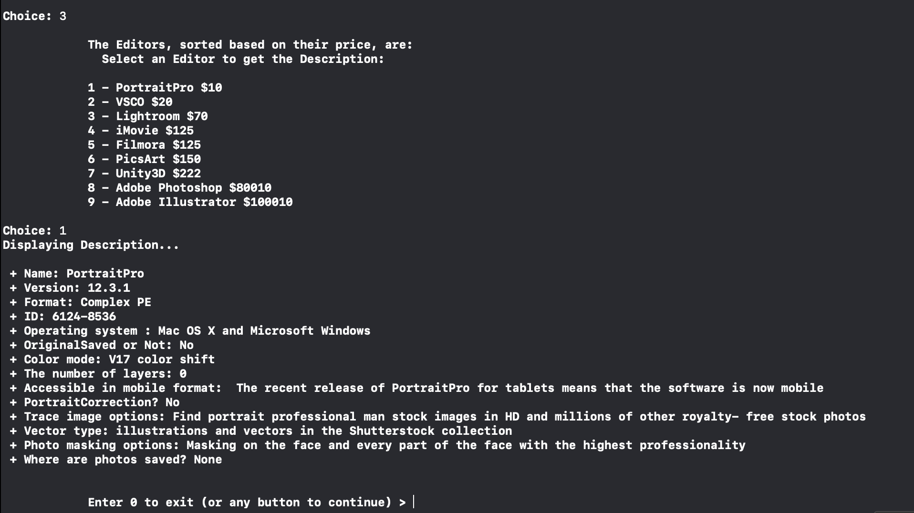
List Editors

Slide 8
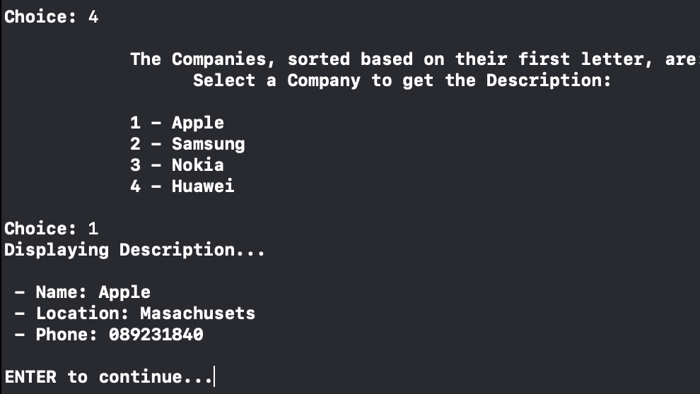
List Companies

Slide 9
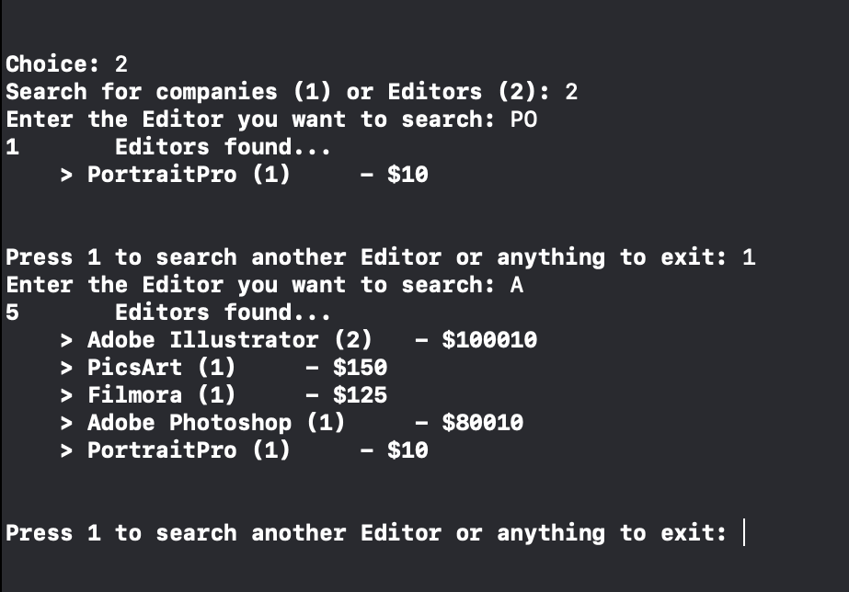
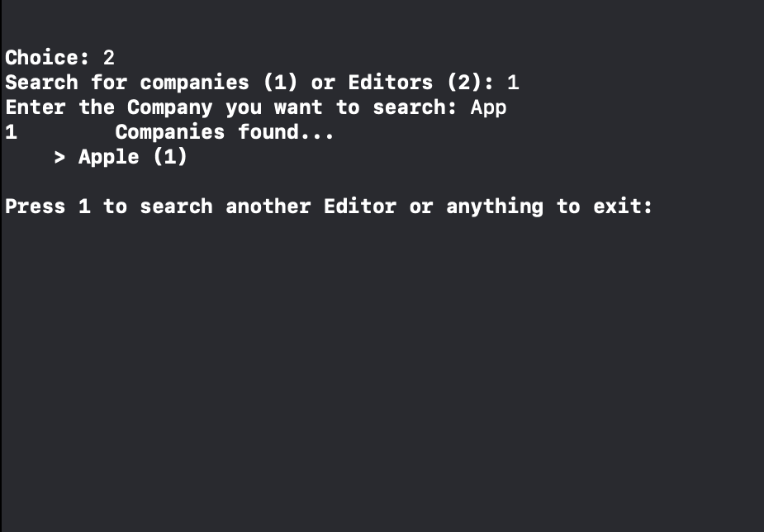
01
02
03
04
Search: Search menu for Companies and Editors

Slide 10
COLLECTIONS
vector < Company* > Companies
vector < Company* > Promoted_Companies;
vector < Editor* > Editors;
vector < pair < Editor*, Company* > > FoundApps;
vector < User* > Users;

Slide 11
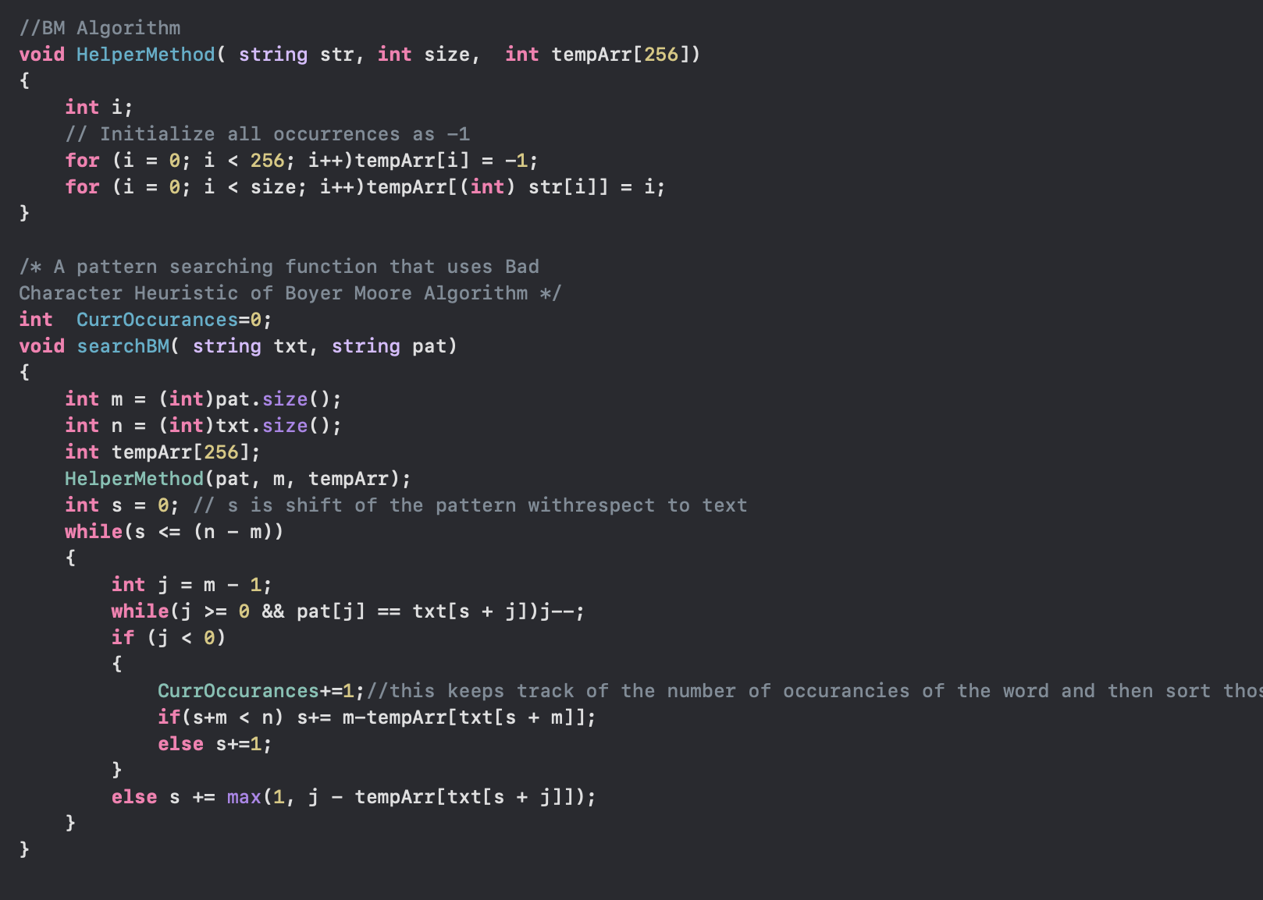
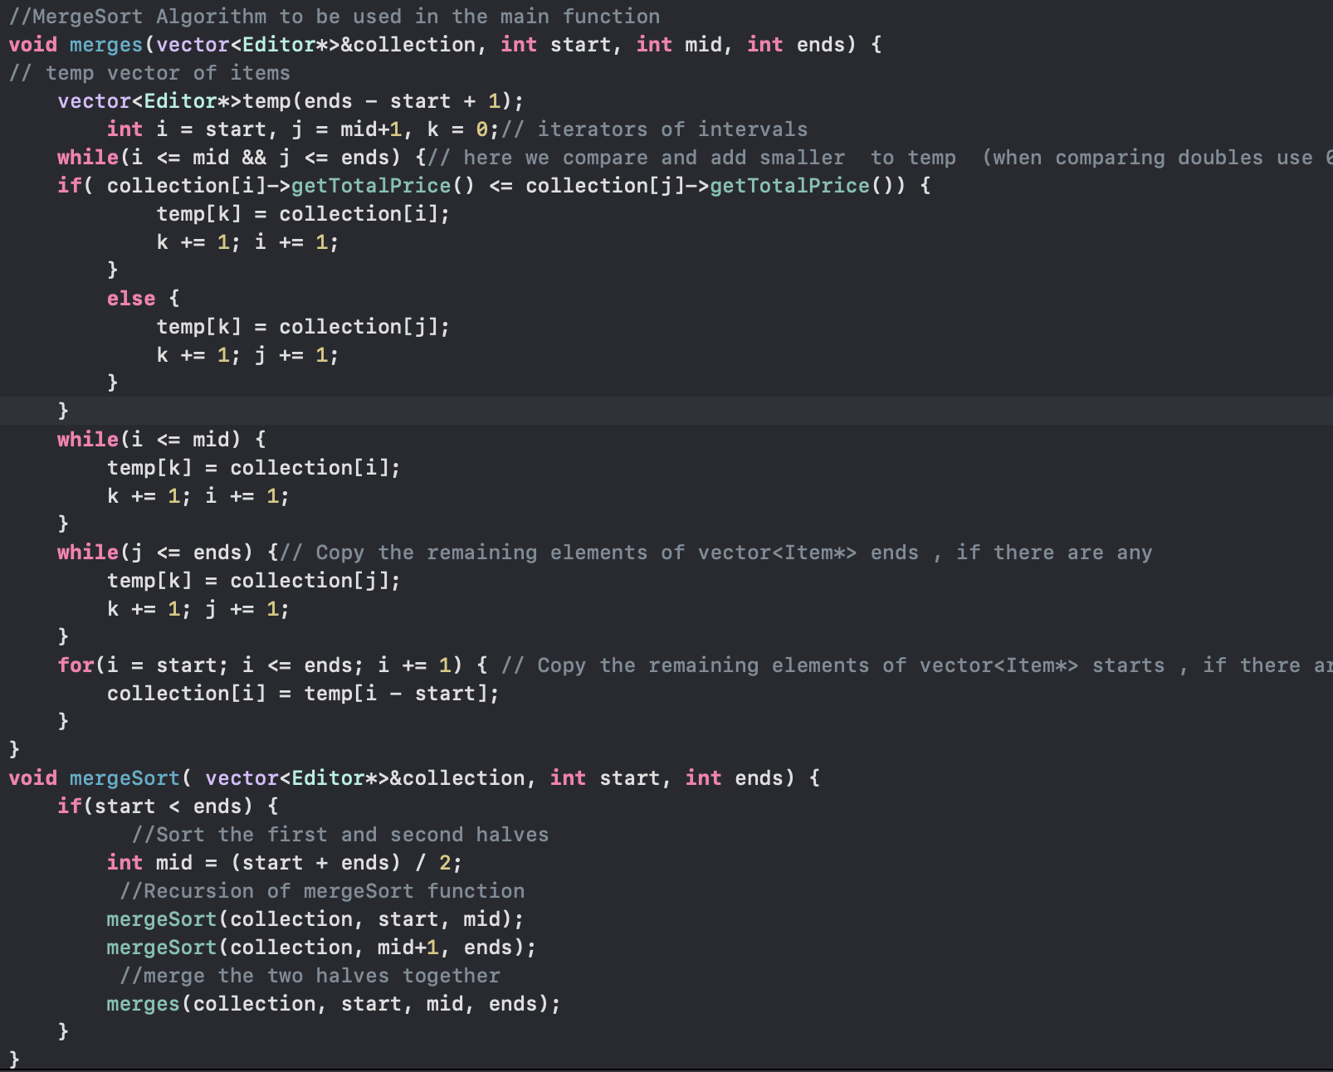
MergeSort is used to sort the Editors based on their total price.
-Time complexity O(nlogn)
Boyer Moore Algorithm is used to search for companies and editors.
Time complexity O(n)

Slide 12
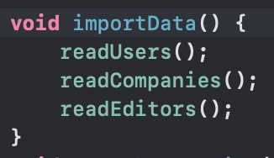


Handling the data
Users are sorted in file Users.txt
Editors are sorted in fine Editors.txt
Companies are sorted in file Companies.txt

Slide 13
THANKS!
QUESTIONS?

